Slide 1
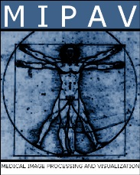

Streamlining the Analysis of Diffusion Tensor Imaging Files Through the Creation of a Mass Image Editor
Sara Shen
Sara.Shen@NIH.gov

Slide 2
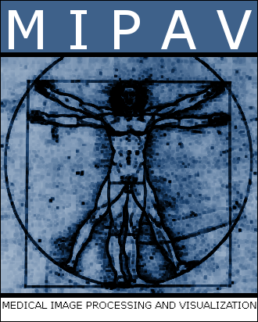
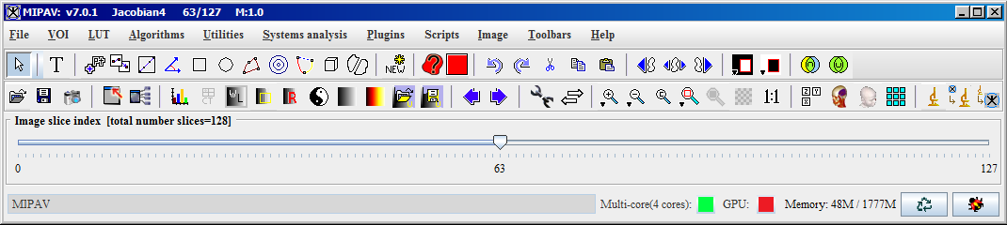

Slide 3
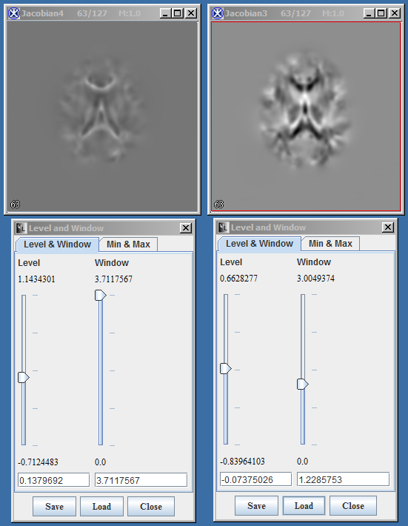
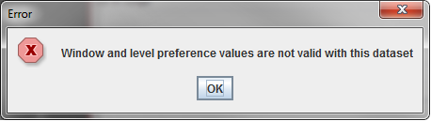

Slide 4
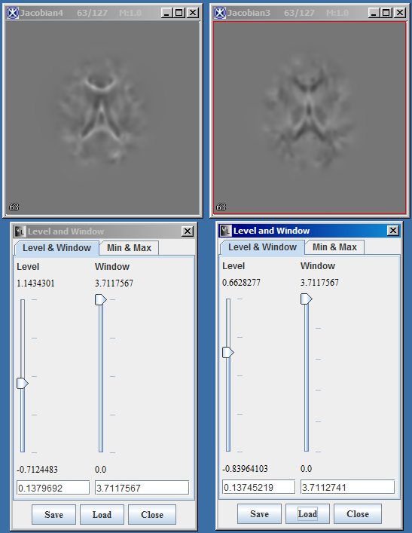
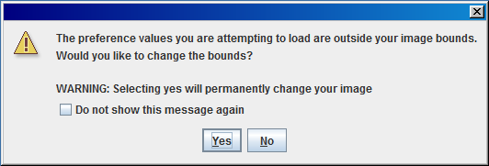

Slide 5
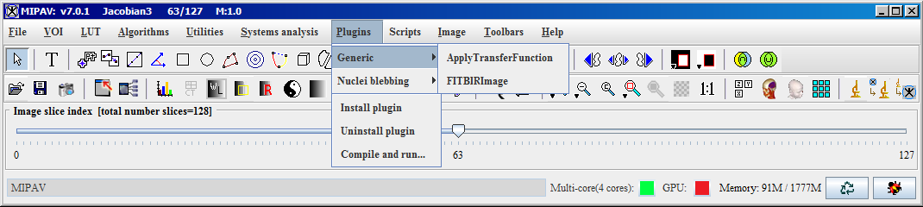
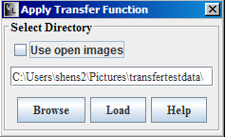
Changes the plugin input mode
Opens the MIPAV wiki article on contrast sliders
Creates contrast sliders that edit all inputted images
Opens a directory browser

Slide 6
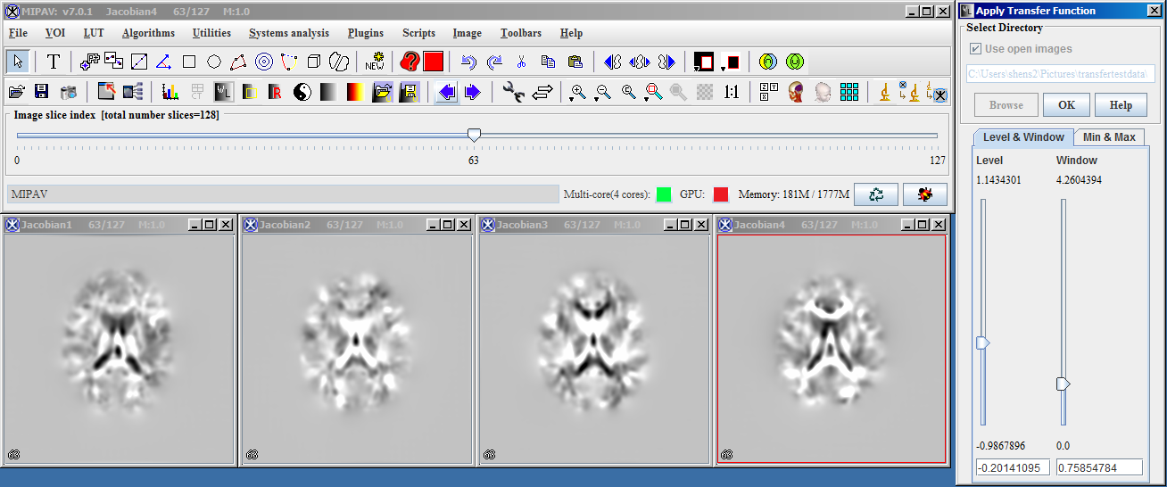

Slide 7
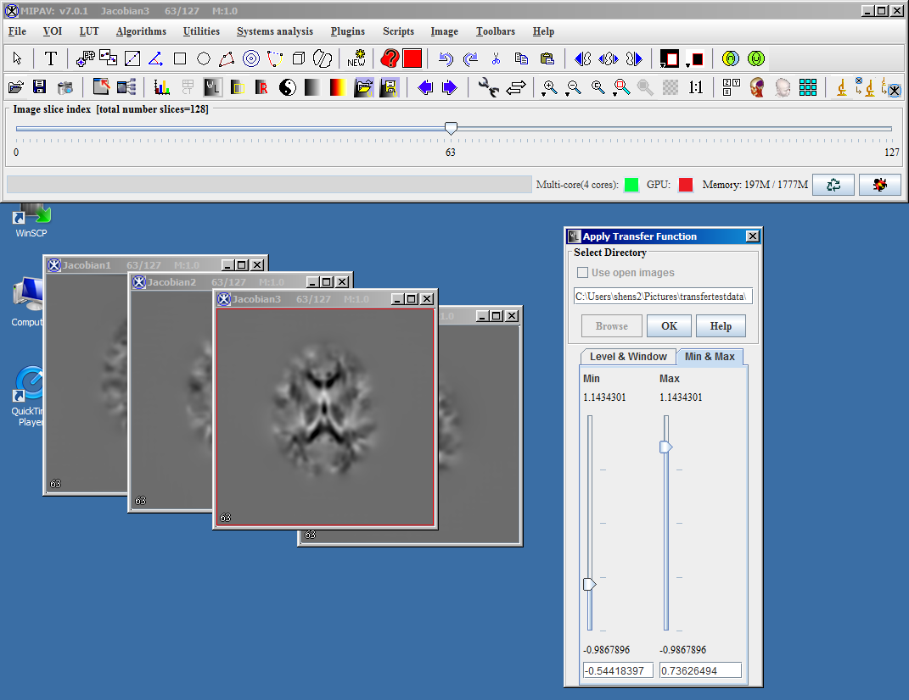

Slide 8
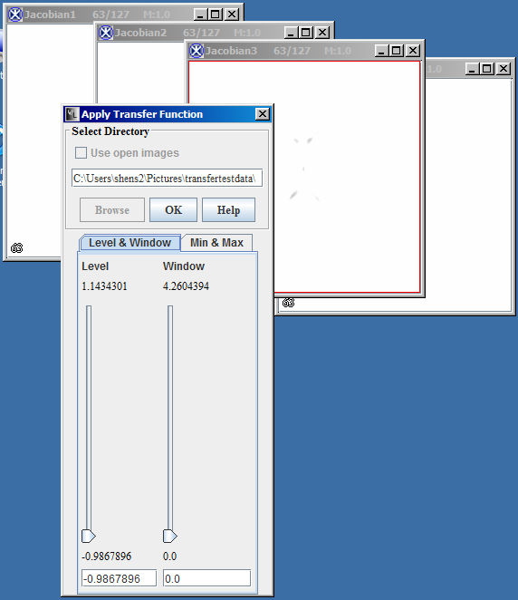
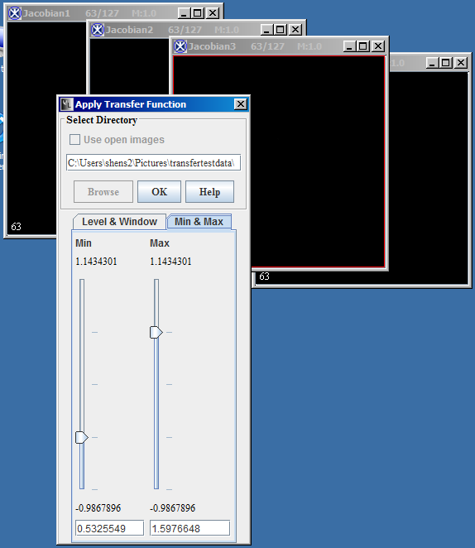
Current Limitations
NIFTI files
Directory loading
Default slider values

Slide 9
Future Improvements
Ability to load transfer functions
Tiling images
Histogram compatibility
Compatibility with other image file types

Slide 10
Acknowledgments
Carlo Pierpaoli’s Team at NICHD
Matthew McAuliffe
Benes Trus
Evan McCreedy
And the rest of the MIPAV team

